Slide 1

Department of Computer Science and Engineering
VII Sem Year: 2026-27
Rogue Access Point Detection & Secure Wi-Fi Authentication Analyzer
NAME | ROLL NO | USN
Sahana V Agadi | 116 | 01FE23BCS091
Srushti B Bammanawadi | 121 | 01FE23BCS098
Sanmati U Shinganmakki | 141 | 01FE23BCS290
Course: Cryptography and Network Security
Course Code: 26ECSC403
Course Guide: Prof. Roopa Badami

Slide 2
Problem Identification
Introduction
Public and organizational Wi-Fi networks can be exposed to rogue or fake Access Points (APs) that imitate legitimate networks.
An attacker can create an AP with the same SSID as a trusted network. Users may unknowingly connect to the fake AP, creating risks such as:
Unauthorized network access
Credential exposure
Man-in-the-middle attacks
Data interception
Connection to an untrusted network
Problem statement
Develop a software-based system to detect potential rogue Wi-Fi Access Points and verify their legitimacy using security analysis and cryptographic authentication mechanisms.

Slide 3
Motivation
Why is this problem important?
Traditional users generally identify a Wi-Fi network using its SSID/name.
However:
SSID
"College_WiFi"
│
┌─────────┴─────────┐
│ │
Legitimate Rogue
AP AP
│ │
WPA2/3 Open/Weak
│ │
└─────────┬─────────┘
↓
Same SSID shown
to the user
Therefore, SSID alone is insufficient to establish trust.
Our motivation
Develop a software-based analyzer that combines:
AP characteristics
Security configuration
Authentication
Cryptographic verification
Suspicious AP detection

Slide 4
Proposed Solution
Shadow Wi-Fi
Shadow Wi-Fi is a software-based Wi-Fi security analyzer that:
Discovers available/represented Access Points.
Identifies duplicate or suspicious SSIDs.
Compares AP security characteristics.
Assigns a security/trust status.
Performs cryptographic authentication.
Detects authentication failures or suspicious configurations.
Alerts the user when a possible rogue AP is identified.
Key idea
Don't trust a Wi-Fi network only because its SSID looks familiar.

Slide 5
Objectives
Detect duplicate or suspicious SSIDs and analyze Access Point (AP) security configurations to identify potential rogue APs.
Compare AP security characteristics and maintain trusted AP profiles for reliable network identification.
Implement cryptographic challenge-response authentication to verify the legitimacy of APs and establish trusted connections.
Verify message integrity using HMAC/hash mechanisms and establish secure session communication after successful authentication.
Generate alerts for suspicious AP activity and maintain security logs for monitoring and analysis.

Slide 6
Functional Requirements
1. AP Discovery Module
The system should collect available AP information such as:
SSID
BSSID
Channel
Security type
Signal information
2. Rogue AP Analysis
The system should:
Detect duplicate SSIDs.
Compare AP characteristics.
Identify security mismatches.
Flag suspicious APs.
3. Authentication Module
The system should:
Generate a challenge.
Receive an authentication response.
Verify the response cryptographically.
Accept/reject the AP based on verification.
4. Secure Communication
After successful authentication:
Establish a session key.
Encrypt communication.
Verify message integrity.

Slide 7
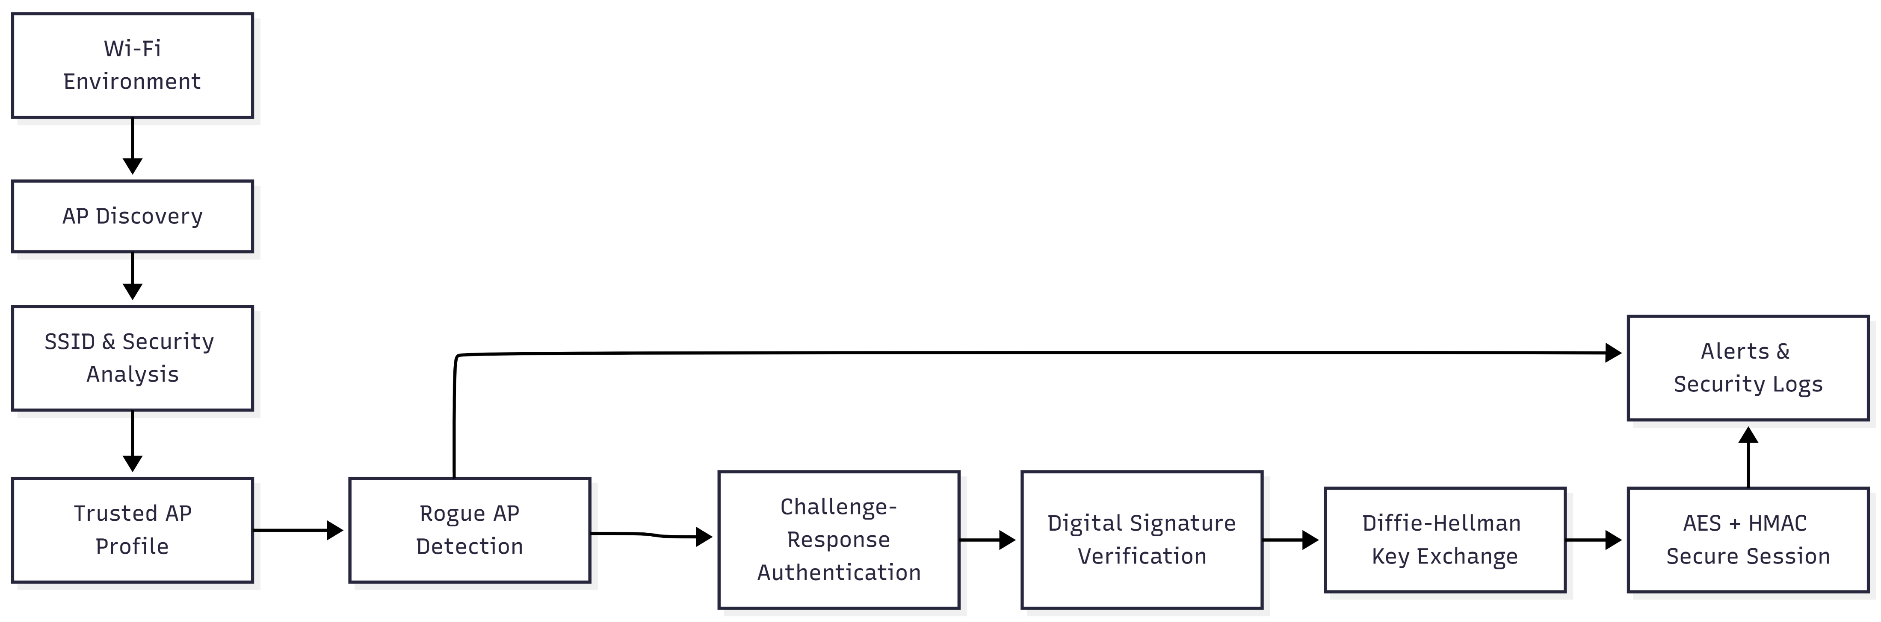
Proposed System Architecture

